Slide 1

Professional Profile
Yasmine Amal
El Batji
Data Analyst & Project Management Professional
14+ Years of Excellence in Data Analysis, IT Project Management & Academic Leadership
amalelbatji1@gmail.com
+212 600 965 978
Rabat, Morocco

Slide 2
Navigation
Profile Overview
01
Professional Summary
02
Core Competencies
Experience & expertise overview
Key skills & strengths
03
Technical Expertise
04
Professional Experience
Tools & certifications
Career journey & achievements
05
Academic Background
06
Publications & Research
Education & teaching
Contributions to the field
07
Awards & Recognition
08
Languages & Activities
Honors & achievements
Multilingual & community

Slide 3

Overview
Professional Summary
Highly skilled project manager with a proven track record of successfully overseeing and executing projects from conception to completion. Currently serving as a Facilitator at the Ministry of Tourism in Morocco for 14 years .
Key Roles
Project Manager & Facilitator
Ministry of Tourism, Morocco
My professional experiences are enriching, and I am eager to share my knowledge and expertise in Project Management and to comply with good practices in Methodology and Benchmark.
International Lecturer
Plymouth University, UK
Program Director
Engineering Schools
I bring a unique combination of technical expertise, leadership abilities, and academic excellence to drive data-informed decision making and project success.
Research Assistant
Al Akhawayn University
14+
4
3
Years Experience
Publications
Languages
Recognition
Fulbrighter 2006
Prestigious International Award

Slide 4

Expertise
Core Competencies & Strengths
Technical Skills
Professional Strengths
Data Analysis
IT Project Management
Leadership Skills
Power BI & Analytics
Full Lifecycle
Proven ability to lead cross-functional teams and drive projects to successful completion
Engineering Innovation
Development & Deployment
System Design
IT Solutions
Problem-Solving Ability
University Lecturing
Collective Intelligence
Analytical mindset with strong capability to identify issues and implement effective solutions
Knowledge Transfer
Diversity Management
Time Management
Emotional Intelligence
Exceptional organizational skills with ability to manage multiple priorities and meet deadlines
Empathy
95%
Risk Management
Ethics
98%
Expertise in identifying, assessing, and mitigating project risks proactively
Communication
92%
Team Collaboration
Strong interpersonal skills fostering productive working relationships across diverse teams

Slide 5
Qualifications
Technical Skills & Certifications
Data Analysis Tools
Professional Certifications
Power BI
Advanced
PMP Certified
Project Management Professional - Industry Gold Standard
Data visualization, dashboard creation, and business intelligence reporting
ITIL v3 Certified
Power Apps
Advanced
IT Service Management Best Practices
Custom application development for data collection and process automation
ISO 27002 Certified
Power Automate
Advanced
Information Security Management
Workflow automation and business process optimization
Certified Mediator
CIMAR - International Center for Mediation and Arbitration
Programming Expertise
Conflicts Manager
C Programming
Java
Visual Basic
Software Engineering
Professional Conflict Resolution Certification

Slide 6
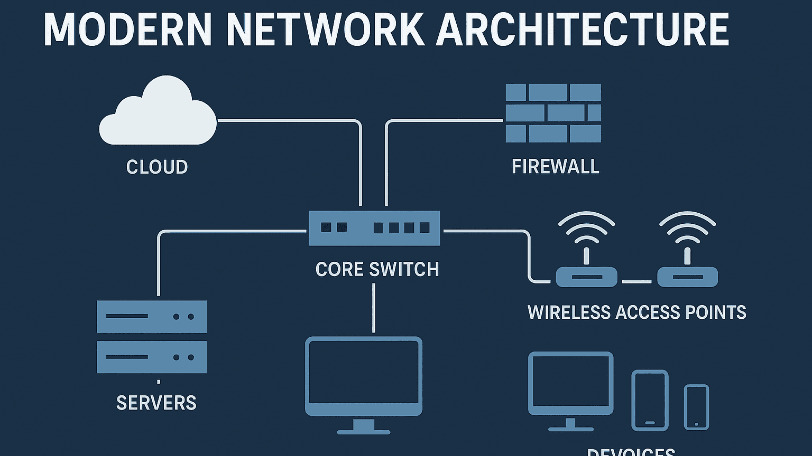
Career Highlights
Professional Experience
Ministry of Tourism, Rabat, Morocco
2011 - Present
Core Responsibilities
14+ Years
Project Manager
Project Development
Needs Analysis
Participate in the development of ministry projects from conception to completion
Analyze functional needs and requirements for IT systems and applications
Facilitator
Data Analyst
IT Systems Specialist
System Design & Development
Environment Setup
Ensure design, development, deployment and maintenance of computer systems
Contribute to preparation of operating environment for new systems
Key Impact Metrics
Monitoring & Evaluation
Continuous Improvement
100%
Monitor and evaluate use of applications developed, track performance metrics
Improve application versions based on user feedback and suggestions
Project Success Rate
Technology Acquisition
Training & Support
50+
Contribute to choice of acquisitions for software development tools
Provide training, assistance and user guides to end users
Applications Deployed

Slide 7

Academic Career
International Teaching Experience
University of Plymouth
2004-2005
Ecole Centrale Supérieure de Génie
2003-2004
Lecturer - Java Programming
Program Director
Plymouth, United Kingdom
Established program of study with teaching and administration staff
International Academic Experience
Al Akhawayn University
2002-2003
IIHEM Rabat
2007-2008
Graduate Research Assistant & Teaching Assistant
Lecturer - C Programming, VB & Computer Skills
C Programming Course - Sponsored conferences on QoS for Wireless Networks
International Institute for Higher Education, Morocco
Computer Engineering School
2006-2007
Teaching Subjects
Program Director
C Programming
Java Programming
Rabat, Morocco - Pedagogical administration and school promotion
Visual Basic
Computer Skills

Slide 8

Academic Foundation
Educational Background
MSc in Computer Networks
2000-2003
Academic Excellence
Al Akhawayn University, Morocco
Advanced studies in network architecture, protocols, wireless communications, and quality of service (QoS) provisioning in cellular networks.
Best Internship Award
School of Science and Engineering, Al Akhawayn University
Recognized for outstanding performance
Focus: 3G WCDMA Networks, QoS Management, Wireless Communications
Key Academic Strengths
Strong technical foundation in software engineering
Advanced knowledge in computer networks & wireless systems
Research methodology & analytical skills
System design & architecture expertise
Technical Knowledge Areas
BS in Software Engineering
1996-2000
Network Architecture
Wireless Systems
Al Akhawayn University, Morocco
Comprehensive foundation in software development, programming languages, system design, and engineering principles.
Software Development
Data Management

Slide 9

Research Contributions
Publications & Research
QoS Provisioning in 3G WCDMA Cellular Networks
IEEE
2004
Conference
2005
QoS-aware Power Control and Handoff Prioritization in 3G WCDMA Networks
An Integrated System for QoS Provisioning in 3G WCDMA Cellular Networks
MWCN 2005
IEEE WCNC 2004
International Conference, Marrakech, Morocco
Wireless Communications and Networking Conference, Atlanta, USA
Ref: 0-7803-8344-3/04 © 2004 IEEE
Research Focus Areas
Journal
2004
3G WCDMA Networks
QoS-aware Power Control and Handoff Prioritization in 3G WCDMA Networks
Third-generation wireless communication systems and wideband code division multiple access technologies
Journal Marocain D'Automatique
D'Informatique et de Traitement du Signal, pp.99-112
Quality of Service (QoS)
Performance optimization, service quality management, and network resource allocation strategies
IASTED
2003
A Testbed for the Evaluation of QoS Provisioning in WCDMA based 3G Wireless Networks
Wireless Communications
IASTED CSN 2003
Power control mechanisms, handoff prioritization, and cellular network architecture
International Conference on Communication Systems and Networks, Benalmadena, Spain
Ref: 393-065, pp.31-36
Research Collaboration
Co-authors:
T. Rachidi
M. Sebbane
H. Bouzekri

Slide 10

Recognition
Awards & Honors
Research Excellence
Master's research thesis publications in prestigious international conferences, demonstrating significant contributions to the field of wireless communications and QoS provisioning.
Fulbrighter 2006
IASTED 2003
Spain
Prestigious International Award
International Conference on Communication Systems and Networks
The Fulbright Program is one of the most widely recognized and prestigious international exchange programs in the world, fostering mutual understanding between nations through academic exchange.
WCNC 2004 - IEEE
Atlanta, USA
IEEE Wireless Communications and Networking Conference
International Recognition
INC 2004
England
International Conference Publication
Award Significance
Recognition of academic excellence and leadership potential
Impact Metrics
International exposure and cross-cultural collaboration
3
3
1
Prestigious global network of scholars and professionals
International Conferences
Countries
Journal Publication

Slide 11

Global Perspective
Languages & Professional Activities
Multilingual Proficiency
Professional & Community Activities
English
Fluent
'Hand in Hand' Charity Association
Professional & Academic
Tutoring Coordinator
Coordinating educational support and tutoring programs for community development
Arabic
Native
Moroccan Democratic Association of Women
Classical & Dialect
Active Member
Supporting women's rights and empowerment initiatives
French
Fluent
Professional & Academic
Women's Empowerment in Feminine Plural
Member
Promoting gender equality and women's professional development
International Experience
Rabat EEAM TEMPLE
Adult Group Member
Academic experience in UK (Plymouth University)
Community engagement and spiritual development
Research presentations in USA, Spain, England
Ribat AlFath Environment Club
Cross-cultural collaboration and communication
Member
Environmental awareness and sustainability initiatives

Slide 12
Thank You
Let's Connect
Open to opportunities in Data Analysis, Project Management, and IT Consulting
Email
Phone
Location
amalelbatji1@gmail.com
+212 600 965 978
Rabat, Morocco
Data Analysis
Project Management
IT Consulting

