Slide 1

PRESENTATION
OF MY IT CAREER
AND RESEARCH INTERESTS
BY: ELBATJI YASMINE AMAL
FACILITATOR AND ENGINEER

Slide 2
1-Academic experience and skills

Slide 3
SKILLS
Team Leadership, Professional, Engineering Management, University Lecturing, Delivering Presentations, Conducting Research, Training and Mentoring to students, Supervising projects, Collective Intelligence and Diversity, IT Project Management, Emotional Intelligence, Engineering Innovation, Writing publications, Empathy and Ethics, Data Analysis, Development and Deployment of IT projects.
DATA ANALYST AND AI EXPERT PROFILE
Highly skilled project manager with a proven track record of successfully overseeing and executing projects from conception to completion. Eager to contribute my expertise to a dynamic team environment. I am currently a project manager and facilitator with over 15 years of experience at the Ministry of Tourism in Morocco, where I manage project development and IT systems. I have also lectured at various institutions, including the University of Plymouth and Al Akhawayn University, focusing on programming and computer skills. I hold a Master's in Computer Networks and a Bachelor's in Software Engineering, along with certifications in PMP, ITIL, and PowerBI. I am fluent in Arabic, English, and French, and I have strong competencies in project management, team leadership, and IT project development.

Slide 4
2-RESEARCH AND CAREER GOALS

Slide 5
- My research interests are about Sustainability modeling and Circular Economy
-I am an Engineer and I have both a bachelor and a master in computer science.
I am currently working in the Ministry of Tourism in Morocco as a project manager and a facilitator, and I have different certificates in project management, ITIL and PowerBI.
-I CAN PRESENT MY PORTFOLIO OF PROJECTS AND PUBLICATIONS, and I would be pleased to work on a new field of research in sustainability modeling and circular economy. I attended 2 conferences of the World Future Energy Summit in UAE, and I was amazed about the latest advancements in sustainability, and I would like to make it my new field of research.
MY RESEARCH INTERESTS
STRENGHTS
Leadership skills, Problem-solving ability, Time management, Team collaboration, Risk management
and Effective communication.

Slide 6
Proposal Idea
I am interested in designing and developing models using PowerBI for sustainability data analysis in real-time.
PowerBI is an excellent tool to analyze and visualize sustainability
We can develop interactive dashboards to monitor environmental performance in real-time.
I plan to expand this framework by using machine learning for predictive capabilities. Machine learning will improve the analysis and prediction of sustainability metrics by using patterns and trends.
I aim to design sustainability metrics that can adapt to changing conditions. Additionally, I will explore the role of policymakers in the metric development process.

Slide 7
3-HONORS AND ACTIVITIES

Slide 8
• Fulbrighter 2006
• Research Thesis publications of a Master in Engineering Research in
Al Akhawayn University, respectively: in IASTED2003 (Spain), WCNC2004-IEEE (USA), and INC2004 (England) conferences.
• Best internship in the School of Science and Engineering, Alakhawayn University.
PROFESSIONAL ACTIVITIES
• Charity association: ‘Hand in Hand’ tutoring coordinator.
• Member of the Moroccan Democratic Association of Women.
• Member of Women's Empowerment in Feminine Plural.
• Member of Adult Group in Rabat EEAM TEMPLE.
• Member of Ribat AlFath Environment Club.
AWARDS AND HONORS

Slide 9
4-Professional Experience

Slide 10
2011-present
Project Manager and Facilitator
Ministry of Tourism, Rabat
• Participate in the development of the Ministry projects.
• Analyze the functional needs.
• Ensure the design, development, deployment and maintenance of computer systems.
• Contribute to the preparation of the Operating environment.
• Monitor and evaluate the use of applications developed.
• Improve application versions taking into account the comments and suggestions of managers and users.
• Contribute to the choice of acquisitions of software development tools.
• Provide training and assistance to users and provide them with user guides.
MY MISSIONS IN THE MINISTRY OF TOURISM IN MOROCCO

Slide 11
5-COMPUTER and english SKILLS

Slide 12
CERTIFICATES
New training in Advanced English Communication in Rabat*
New training in Artificial Intelligence in Casablanca*
Training as Data Analyst in Casablanca*
B2 IELTS SCORE OF 6
First student score in Advanced English Certificate
3 Certificates of USA Embassy in Rabat about student assessment
Teaching C programming and VB.NET
Digital Transformation and Its Application in Tourism Certificate
Getting LinkedIn certificates in Introduction to Artificial Intelligence
PMP, ITIL and Project Management trainings and Certificates
PowerBI, Power Apps and Power automate Trainings and Certificates
Conflicts Manager Certificate
ITILv3 and ISO 27002 certificates
Certificate of Mediator from International Center CIMAR for Mediation and Arbitration of Rabat

Slide 13
ALL MY DIPLOMAS ARE STAMPED
BY EMIRATES* EMBASSY IN RABAT*

Slide 14
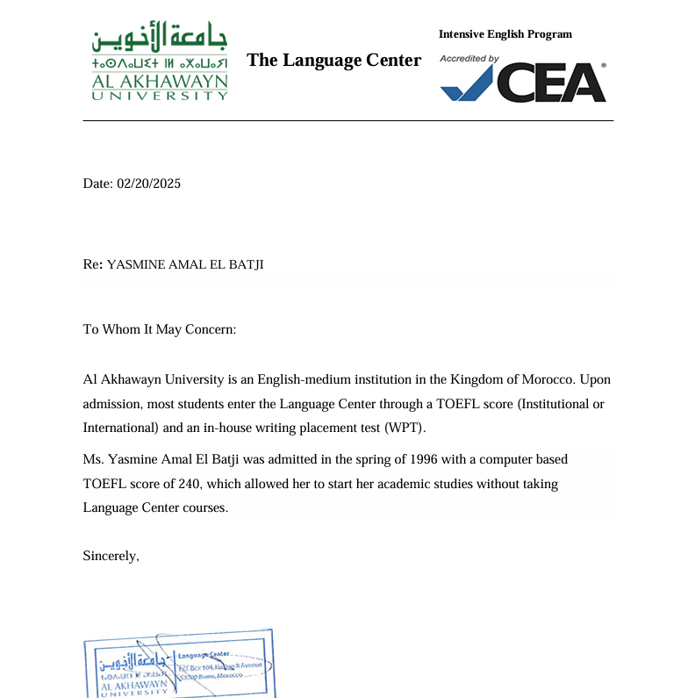

Slide 15
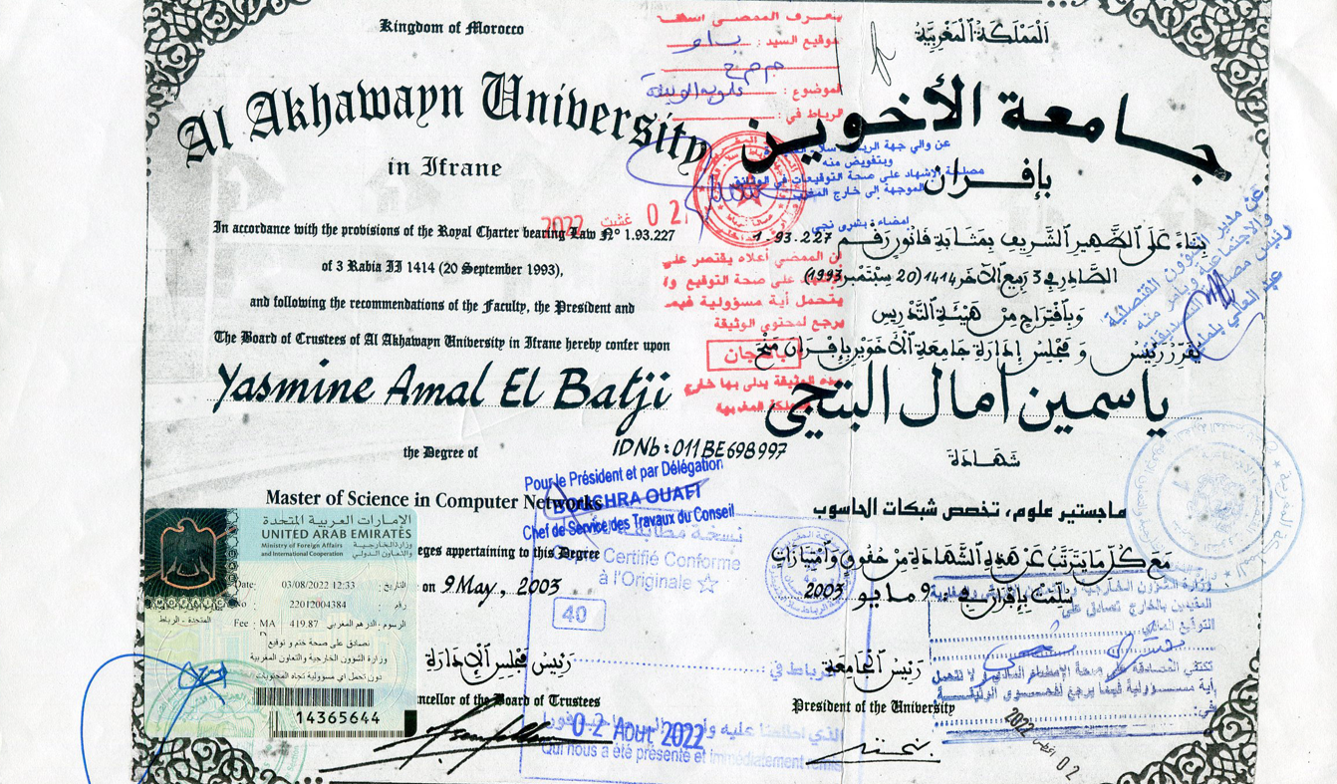

Slide 16
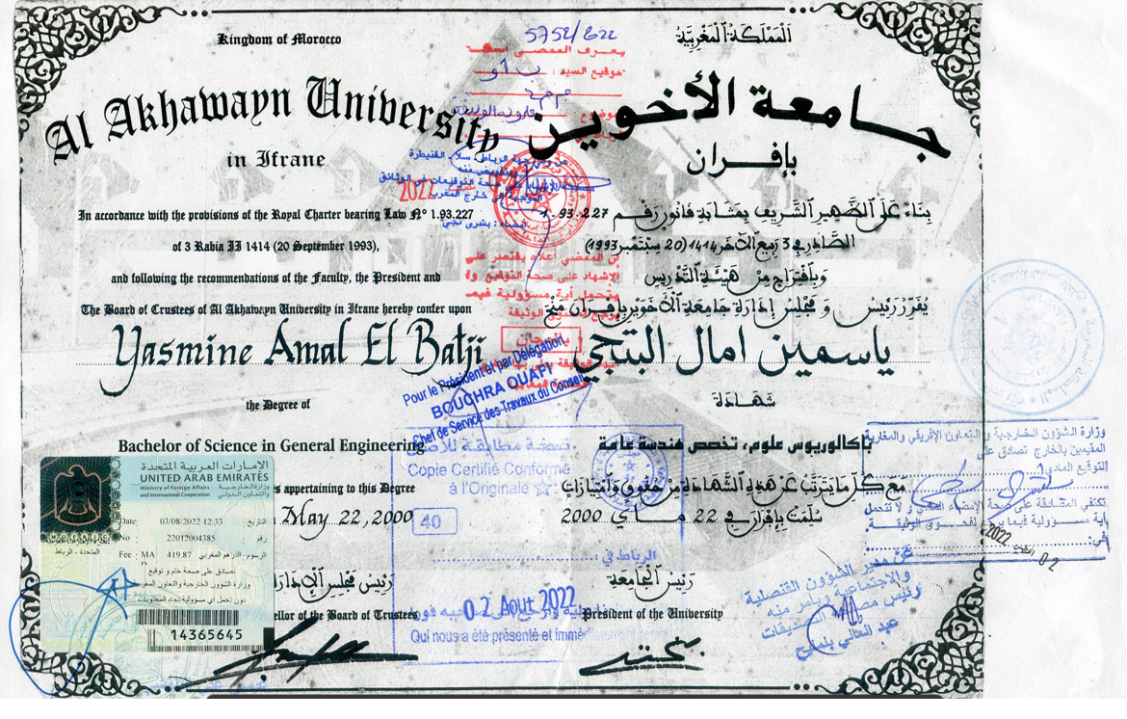

Slide 17
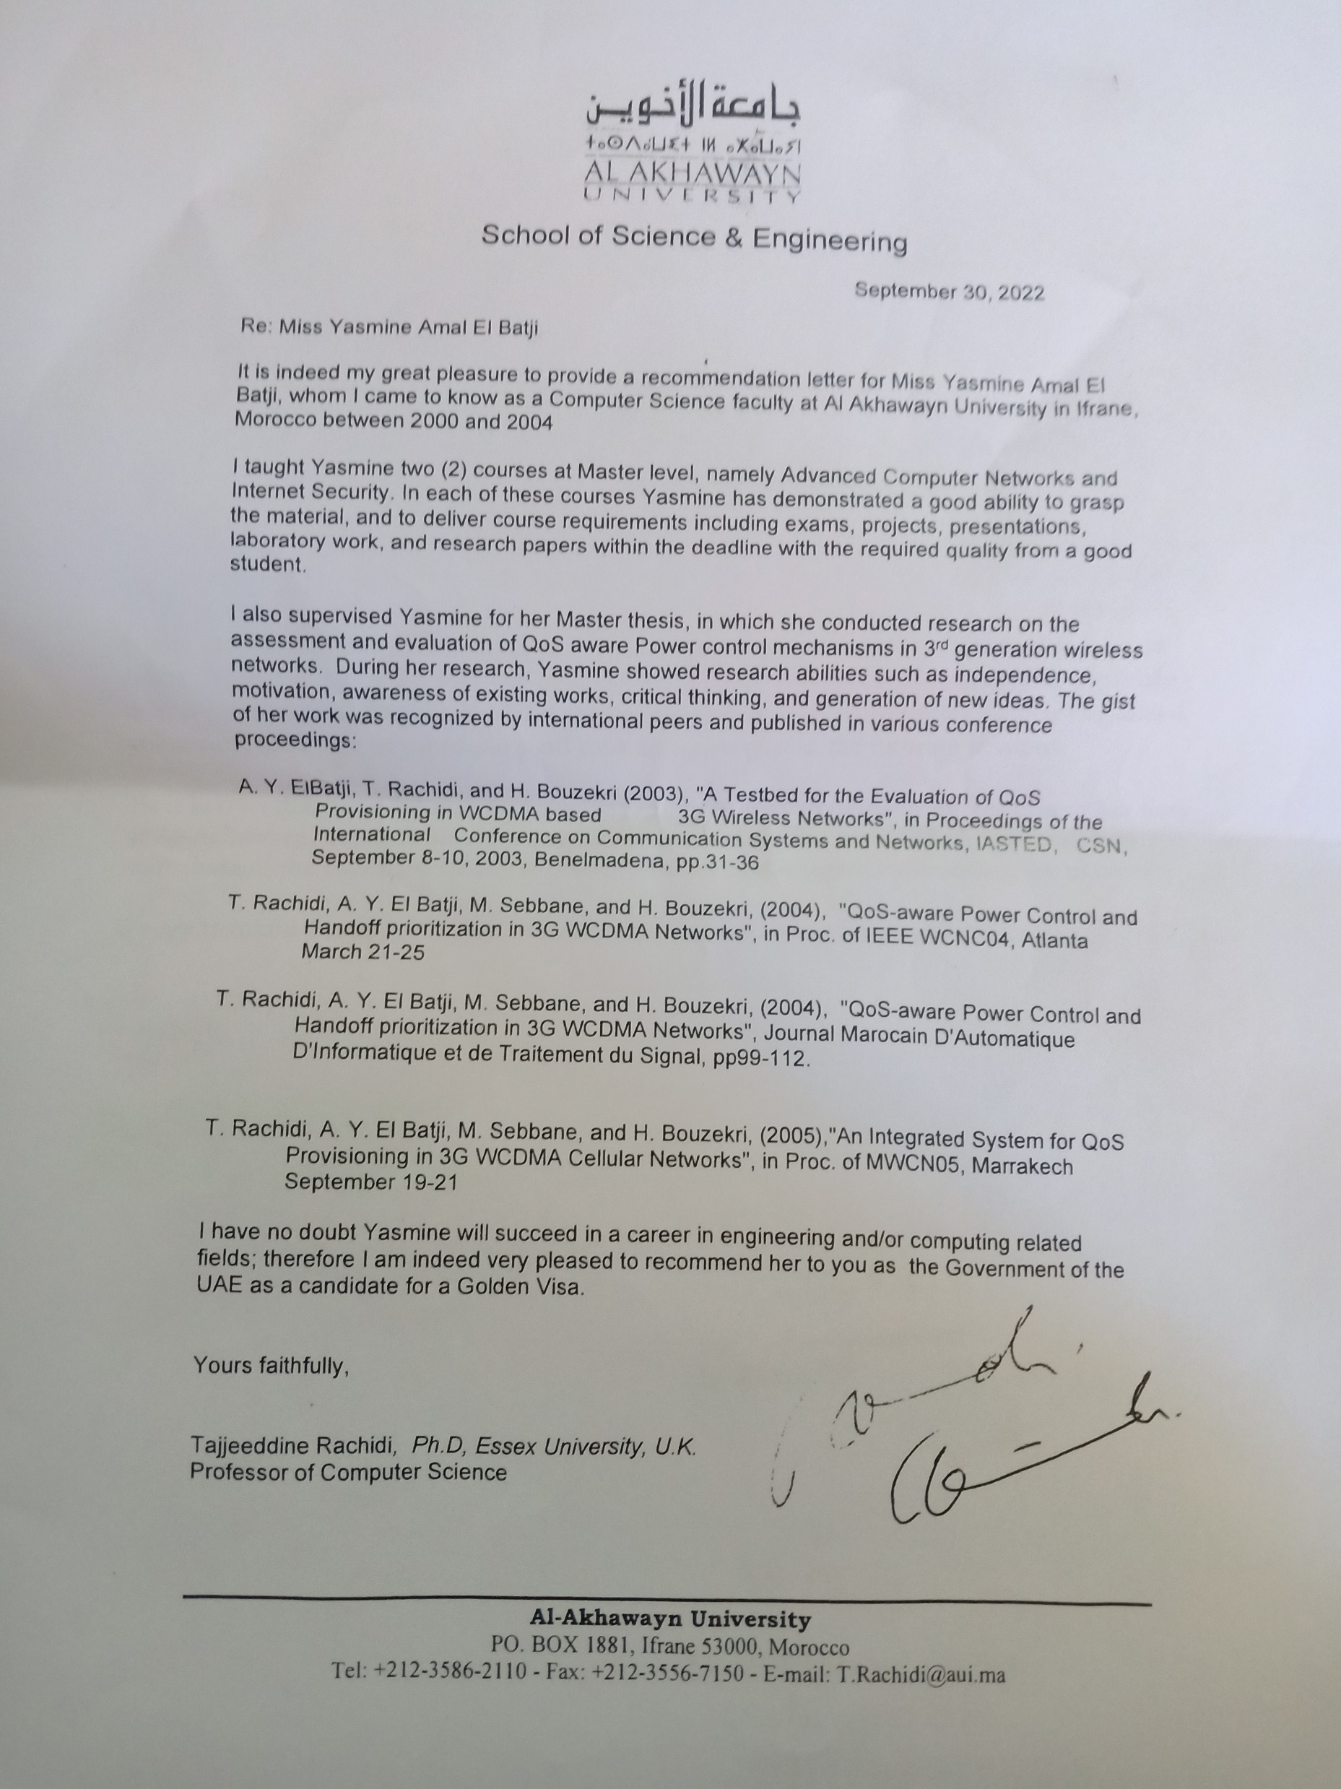

Slide 18
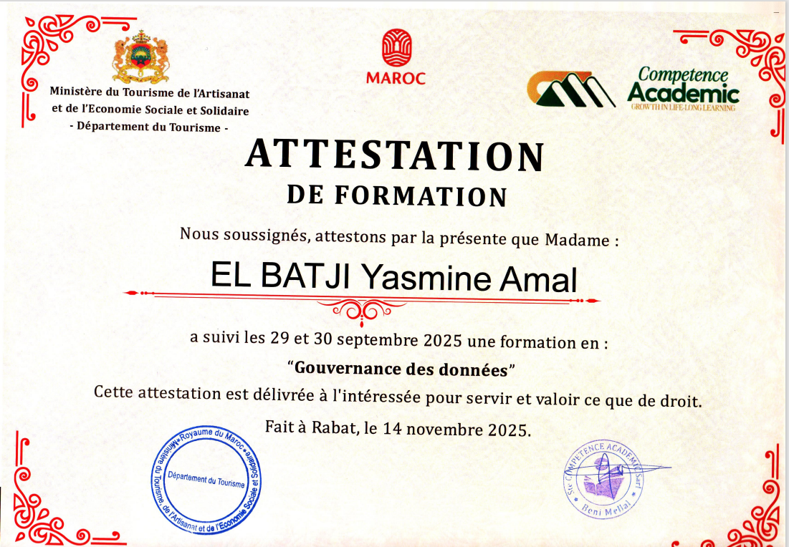

Slide 19
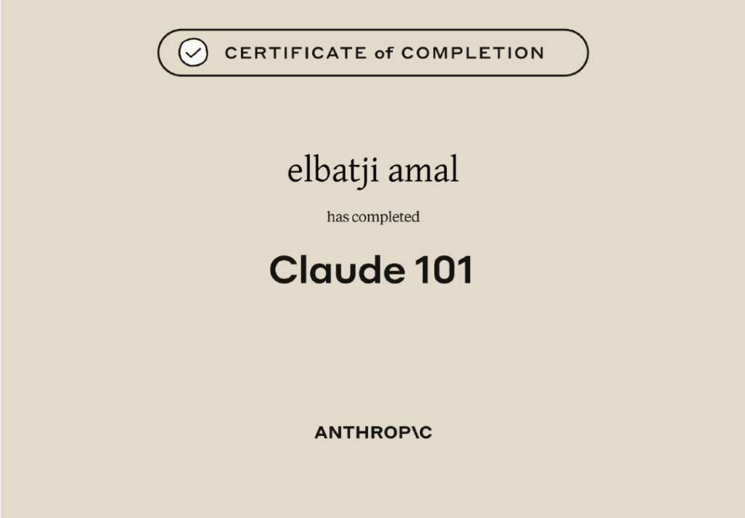

Slide 20


Slide 21
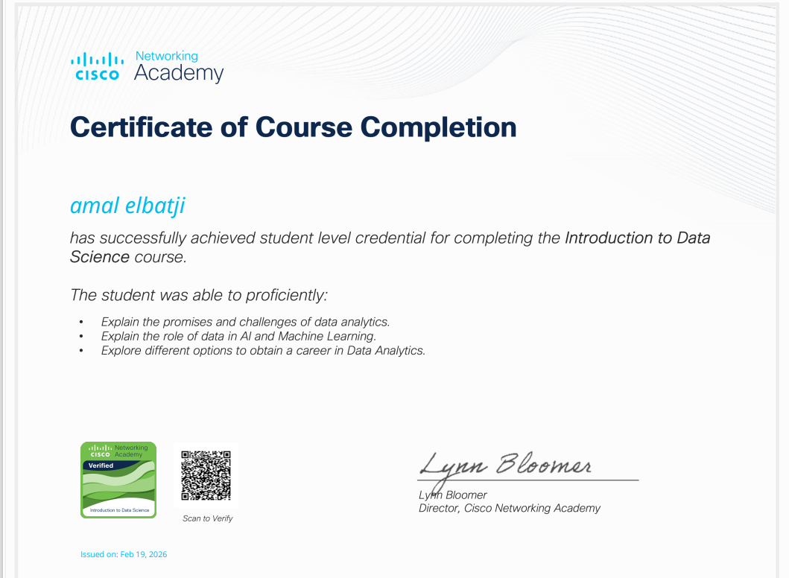

Slide 22
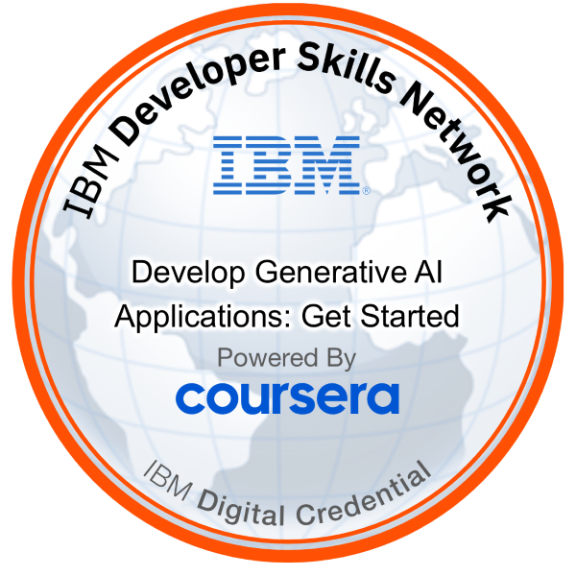

Slide 23
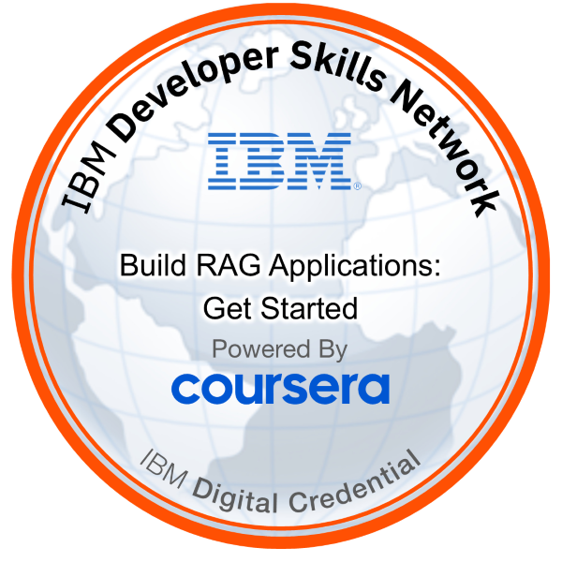

Slide 24
4 AI IBM* CERTIFICATES

Slide 25
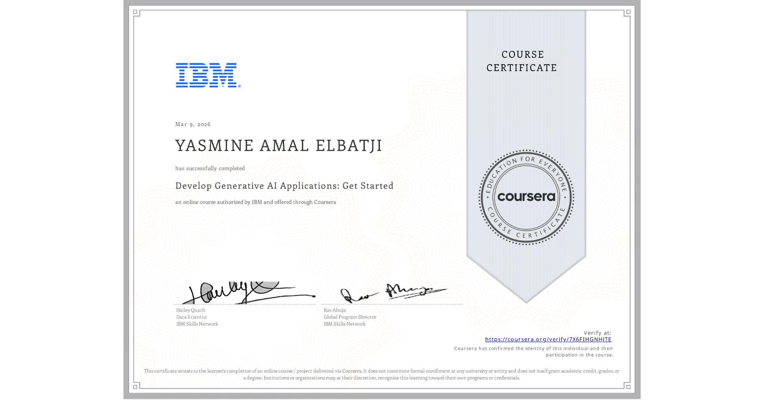

Slide 26
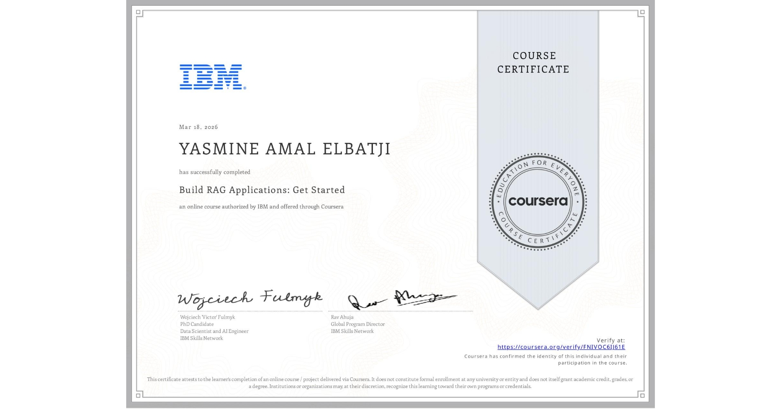

Slide 27
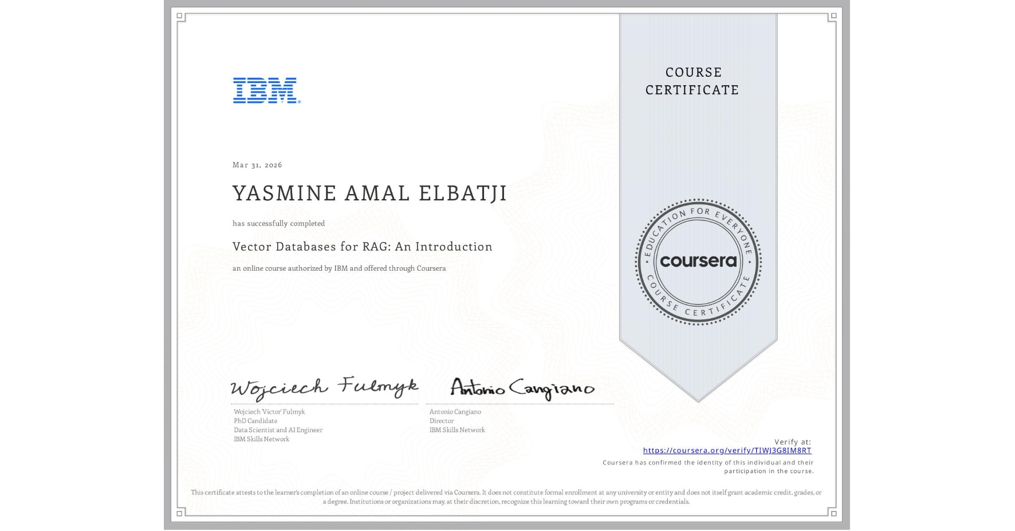

Slide 28


Slide 29
7 MICROSOFT* POWERBI CERTIFICATES

Slide 30
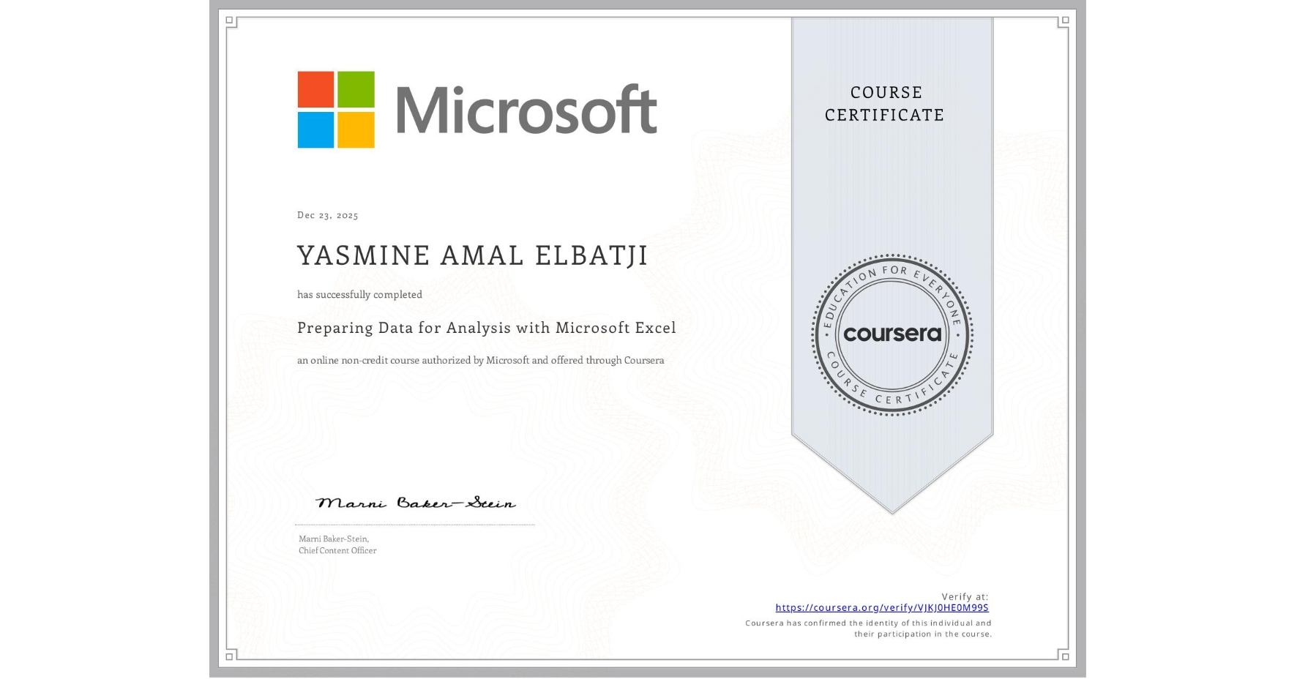

Slide 31


Slide 32


Slide 33
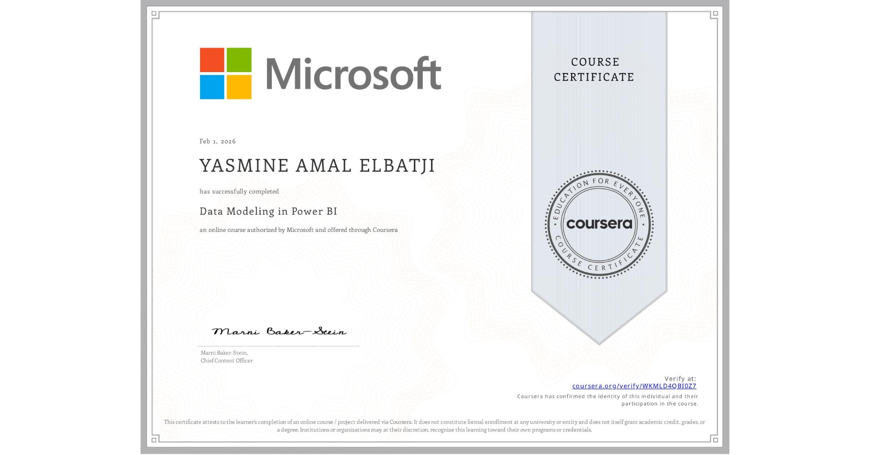

Slide 34
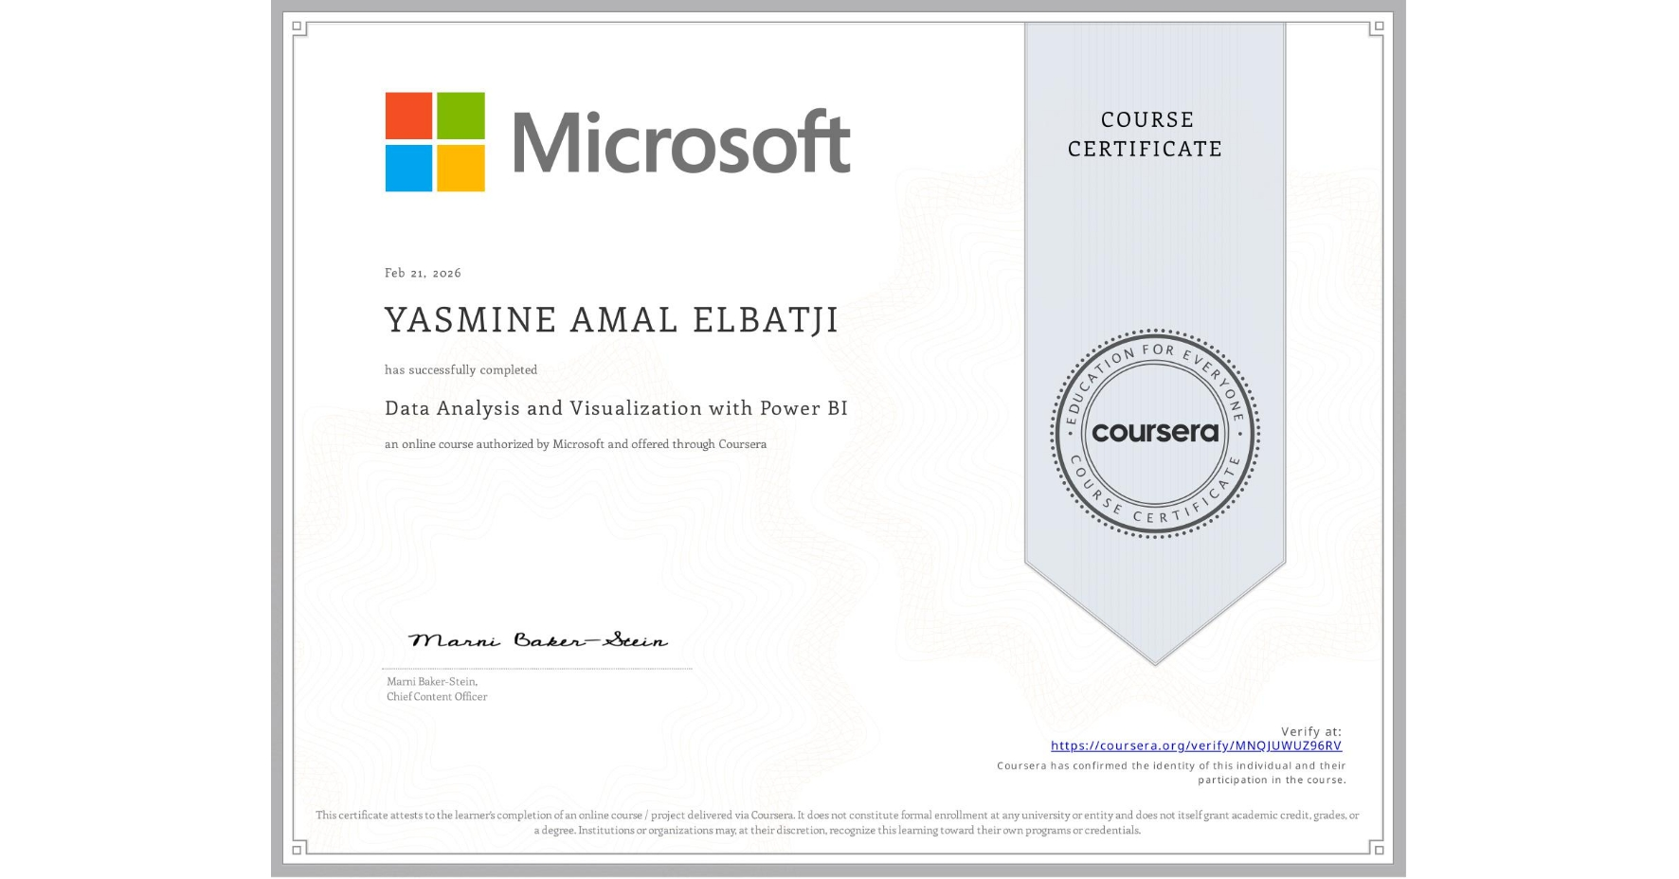

Slide 35
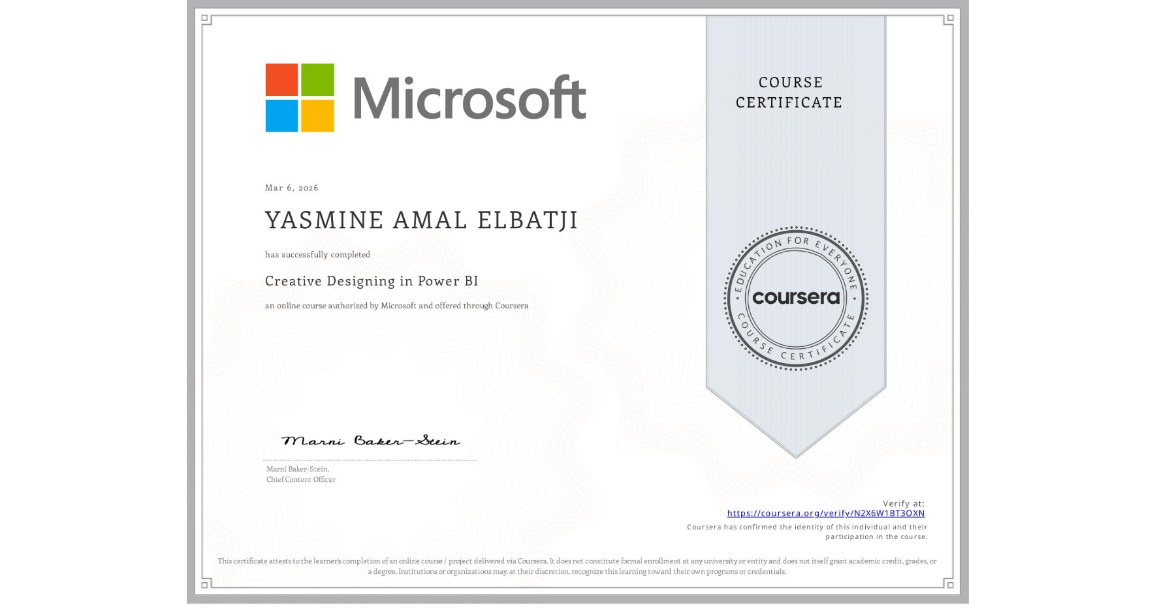

Slide 36
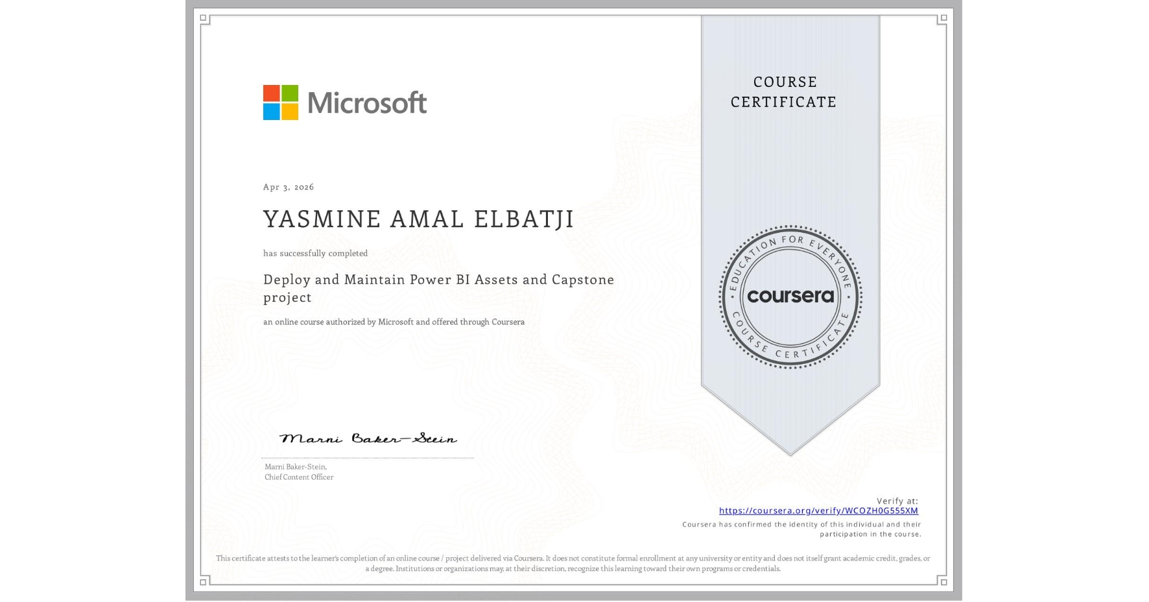

Slide 37
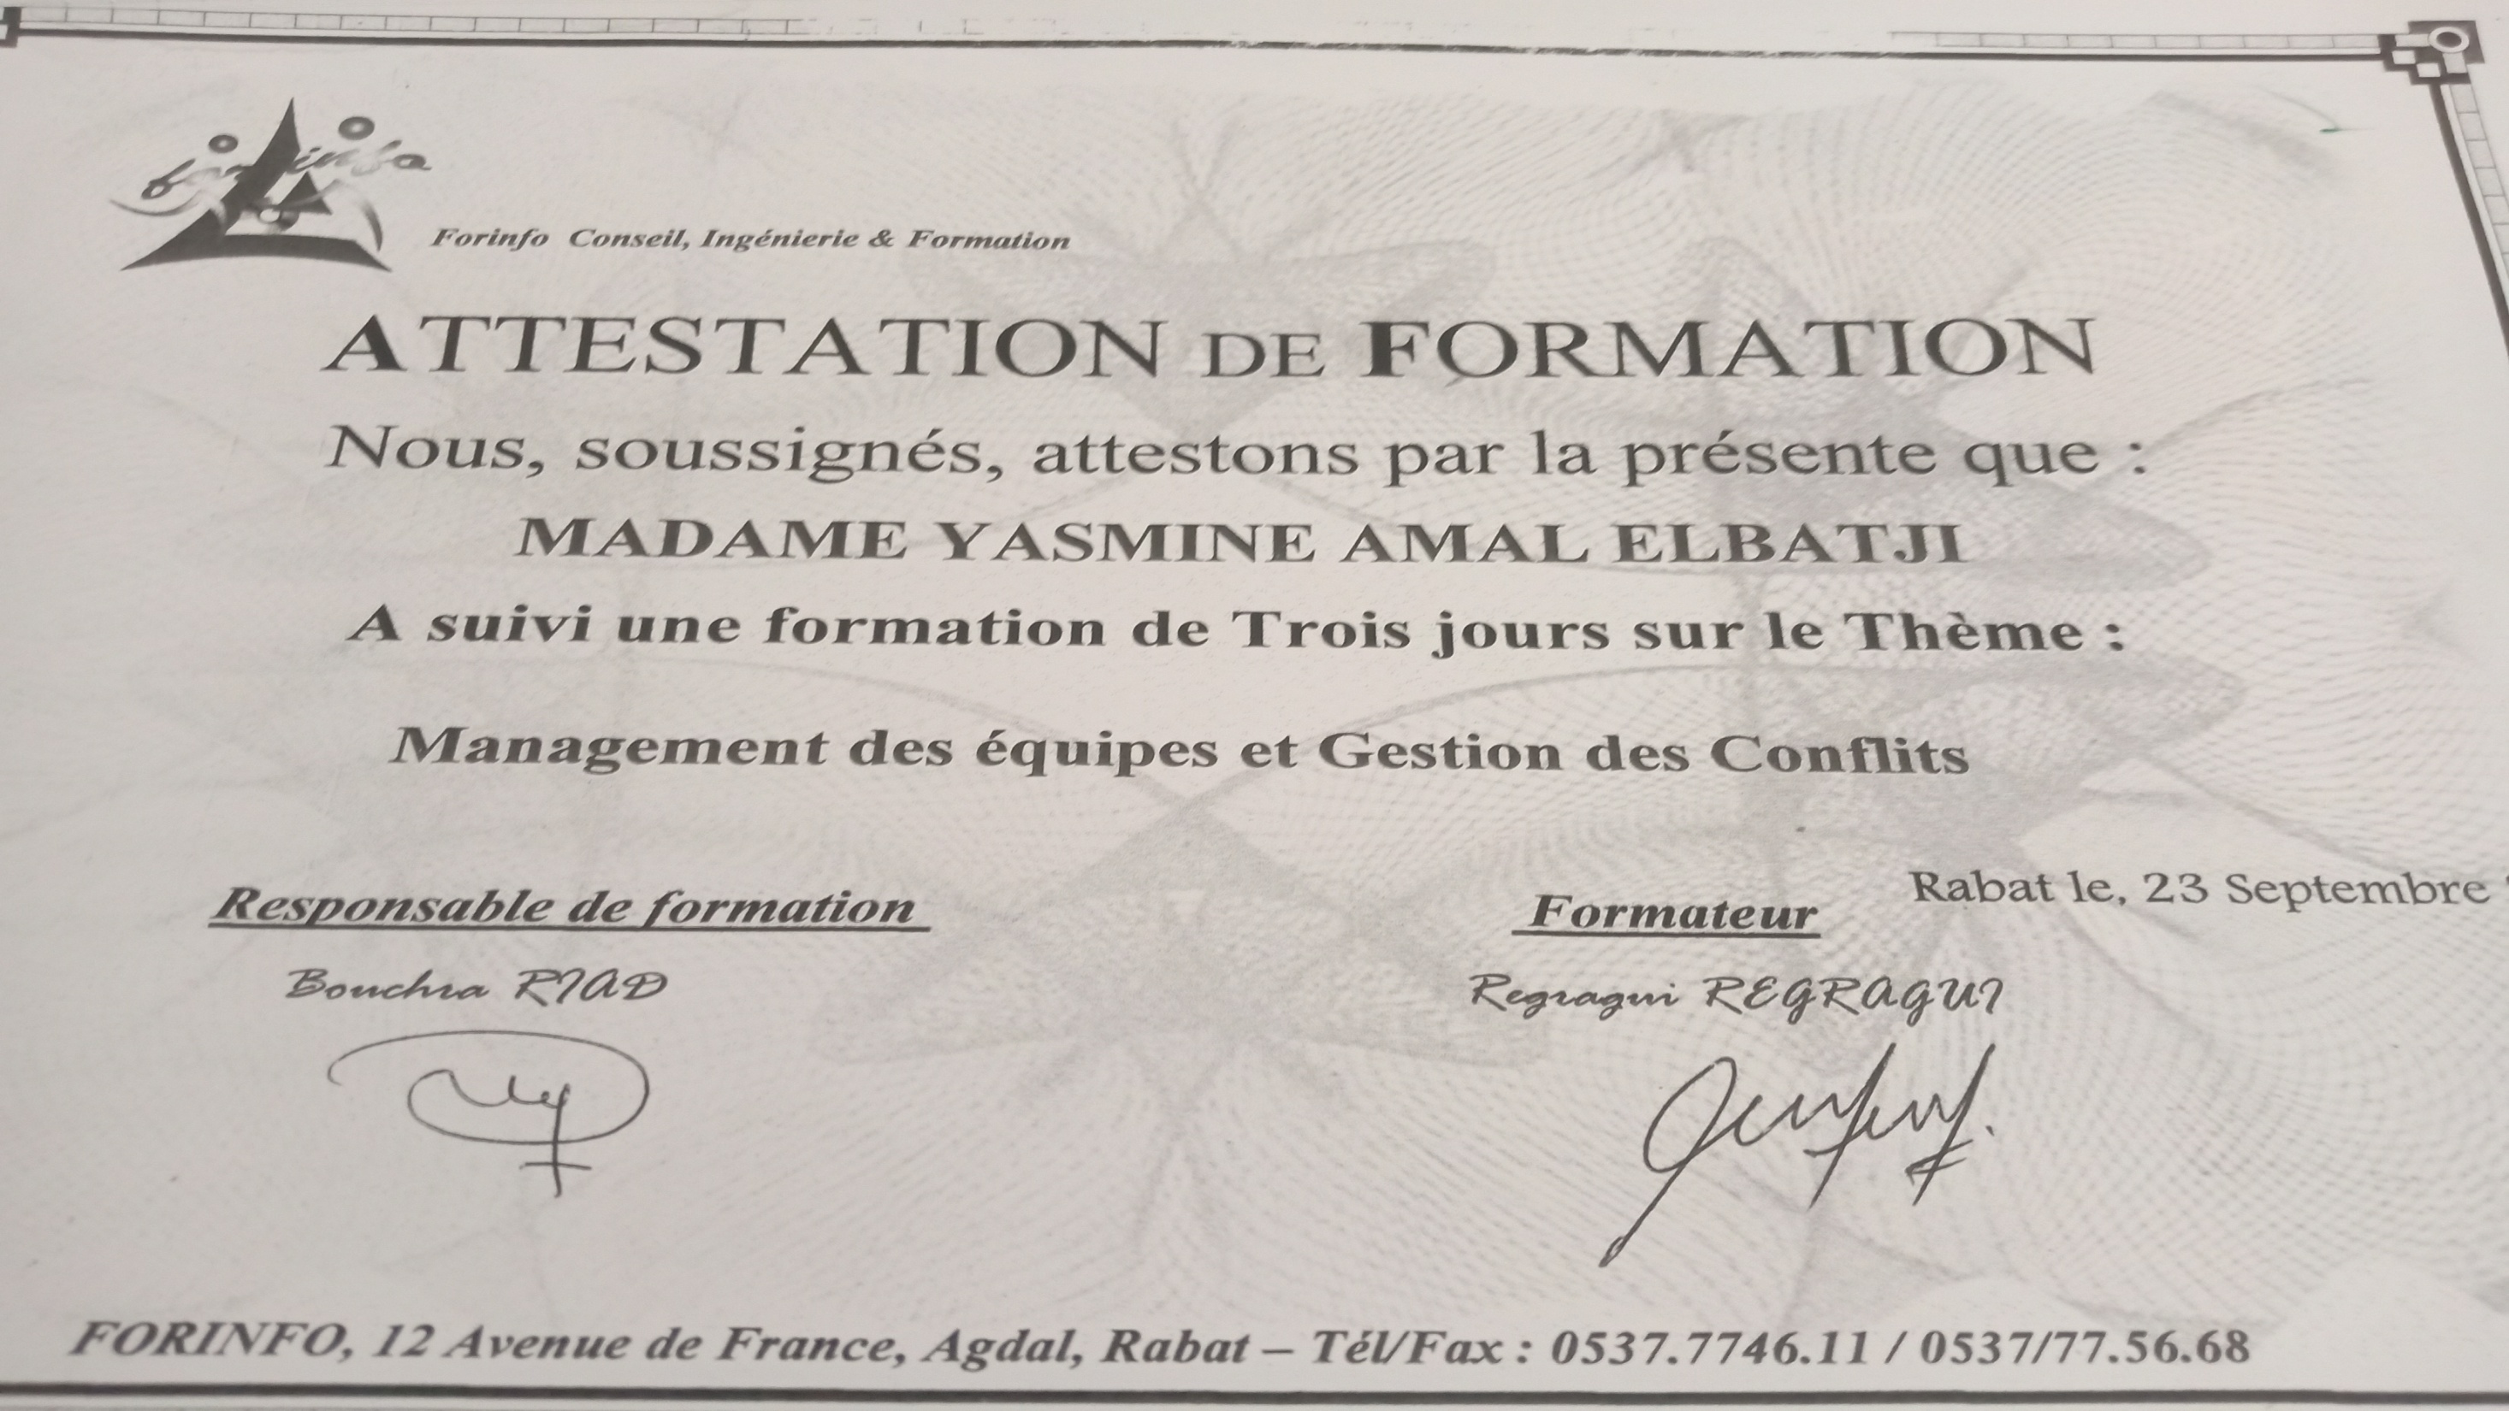

Slide 38
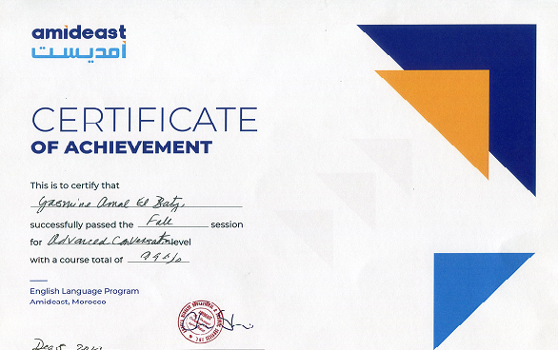

Slide 39
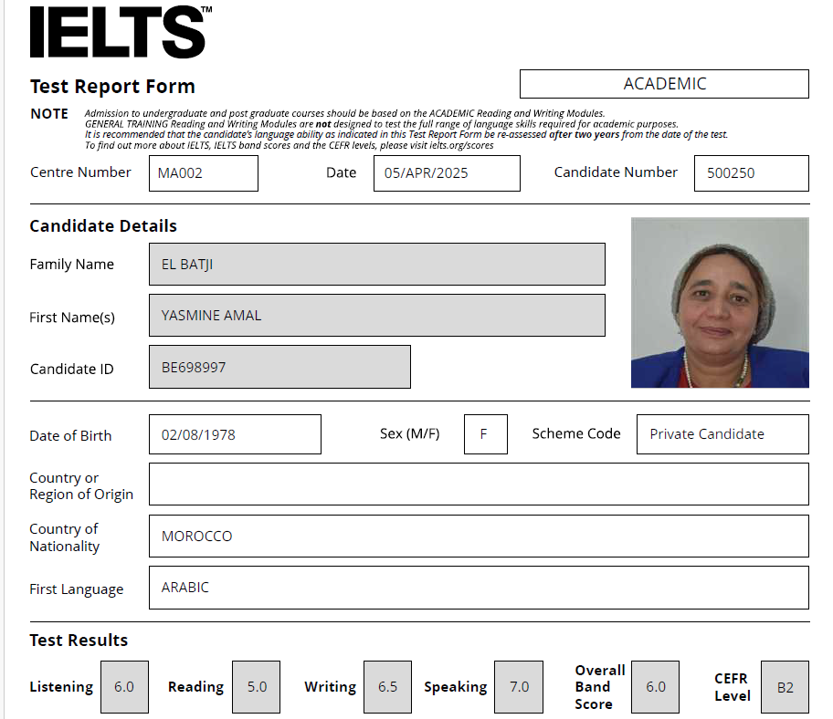

Slide 40
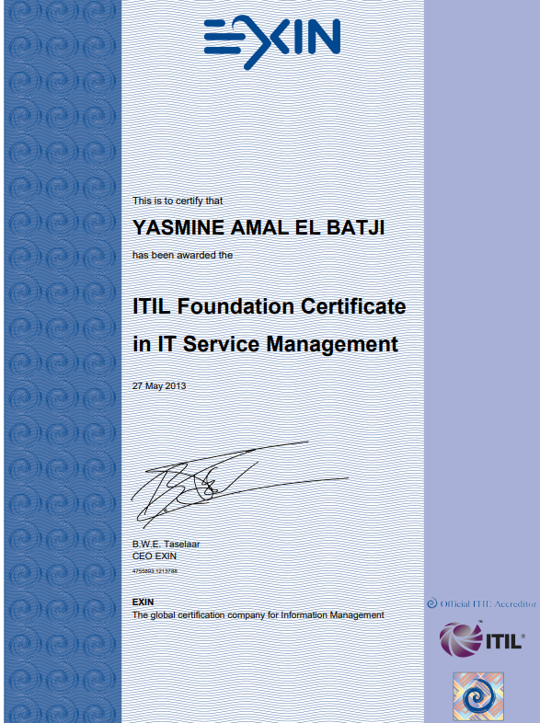
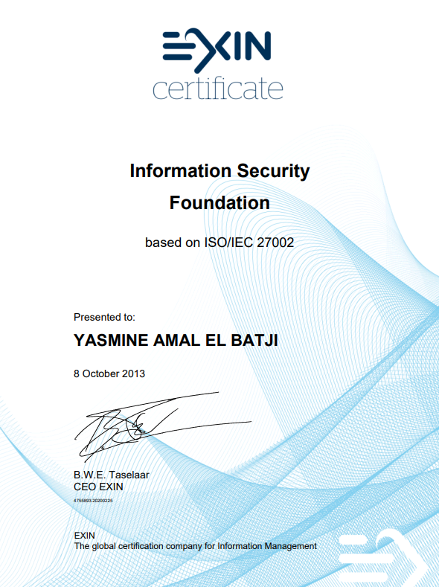

Slide 41
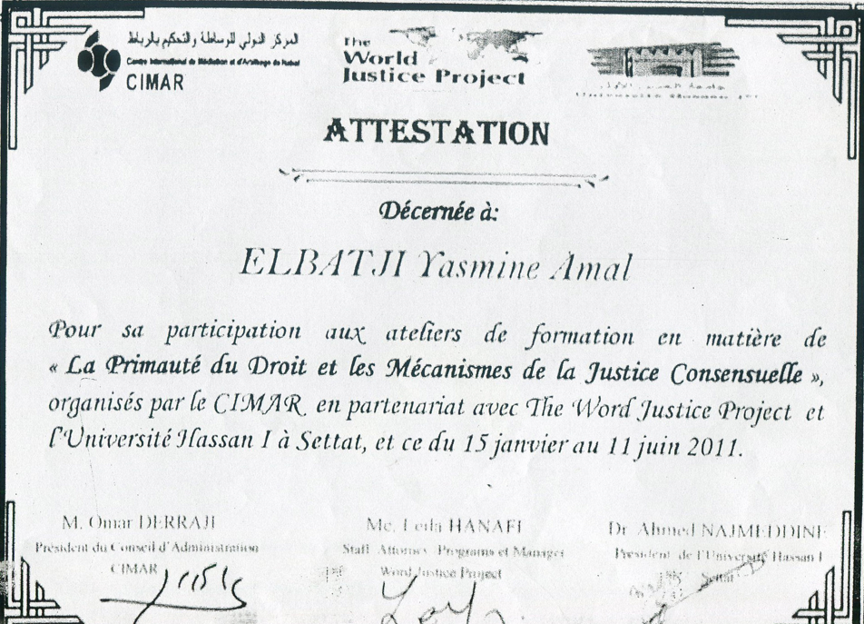

Slide 42
3 ONLINE TRAININGS
WITH USA* EMBASSY IN RABAT*
IN STUDENT ASSESSMENT

Slide 43
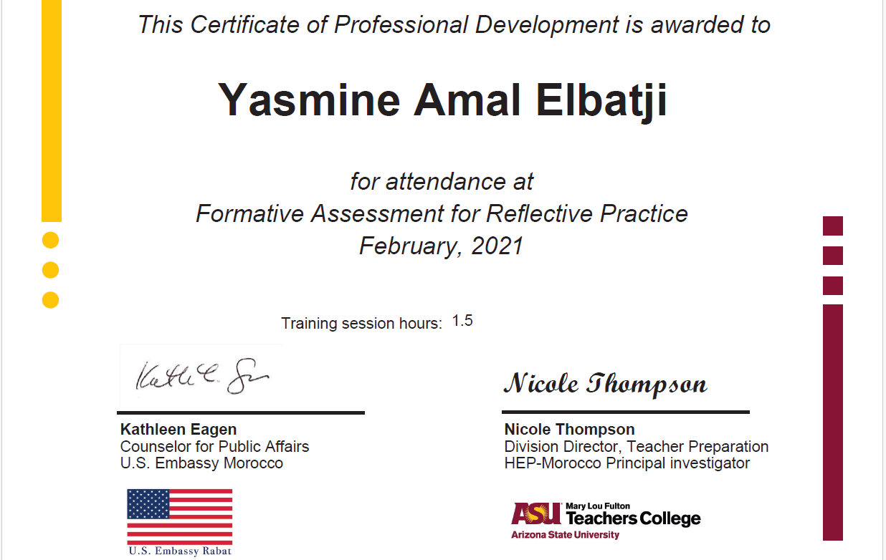

Slide 44
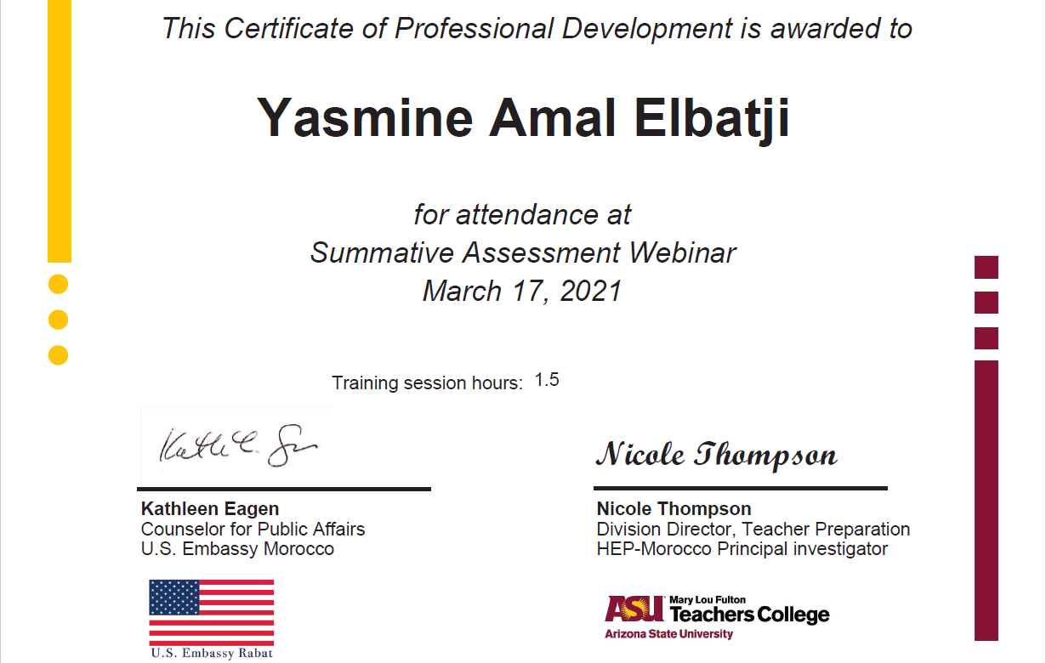

Slide 45
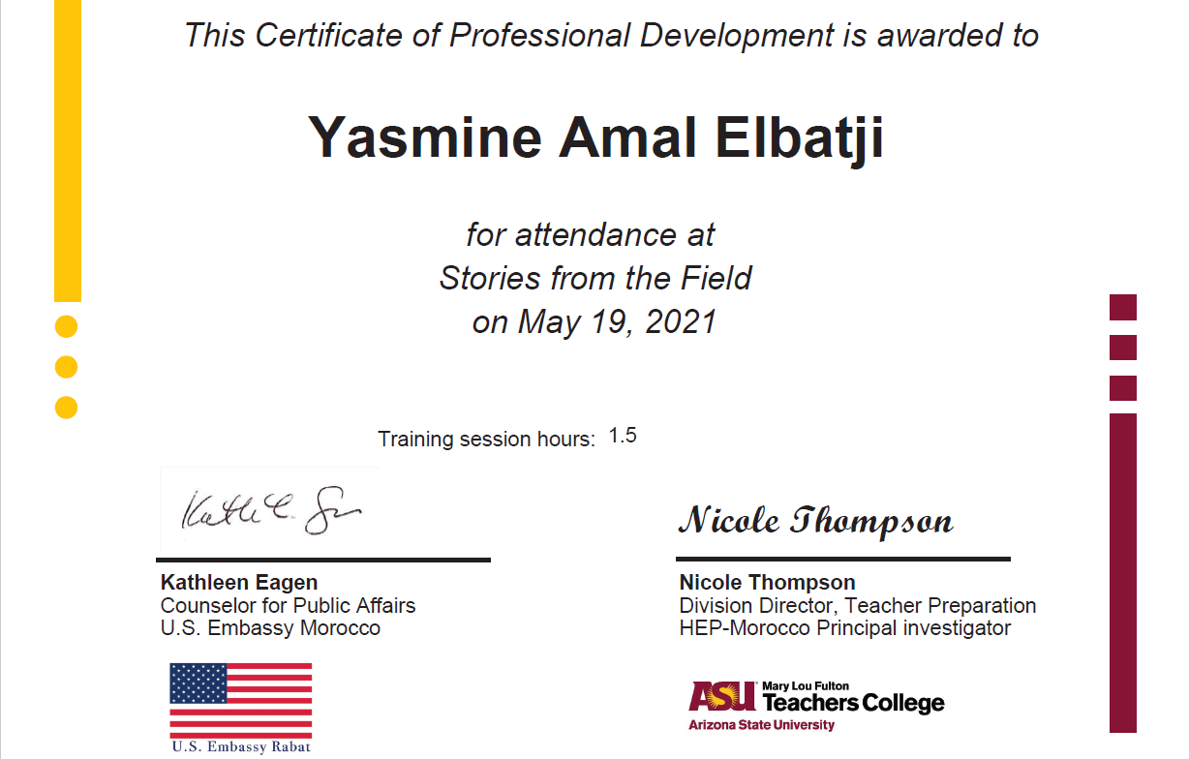

Slide 46
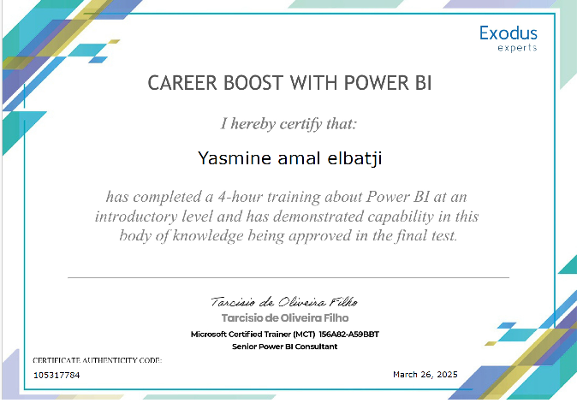

Slide 47
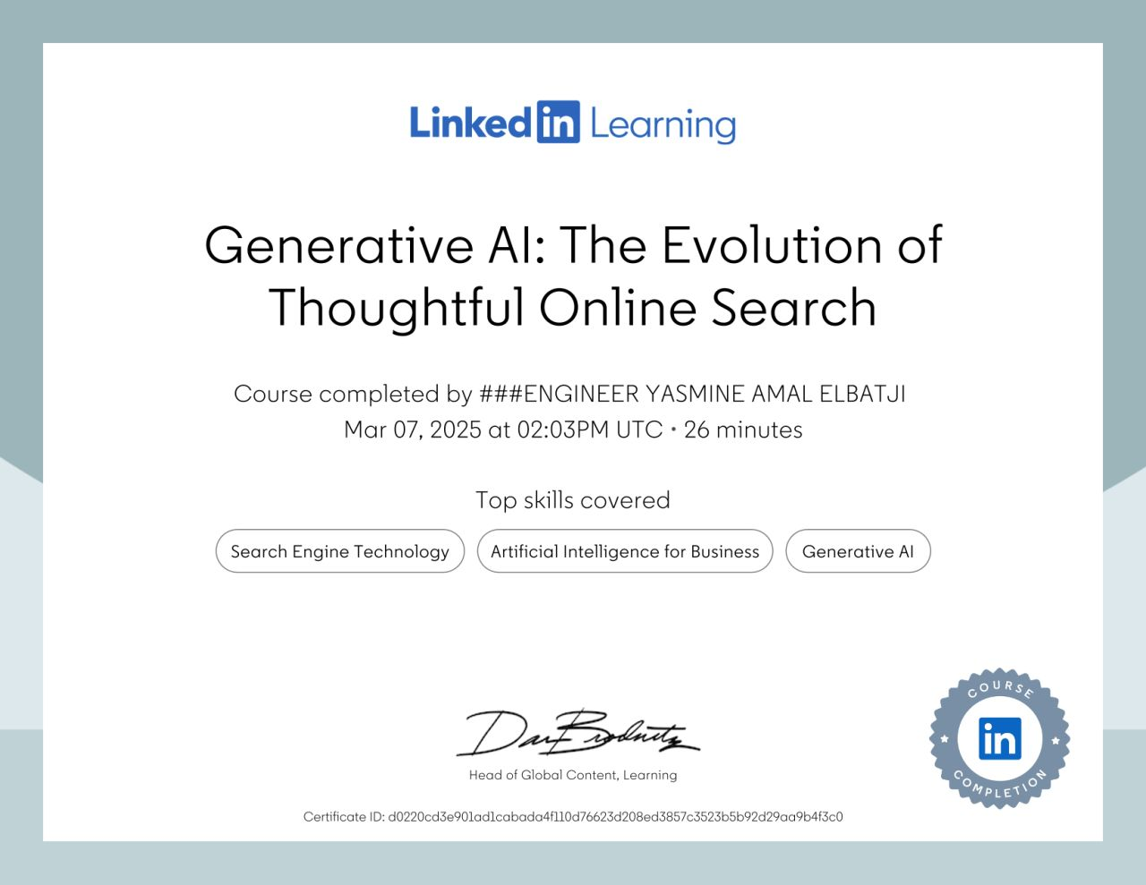

Slide 48
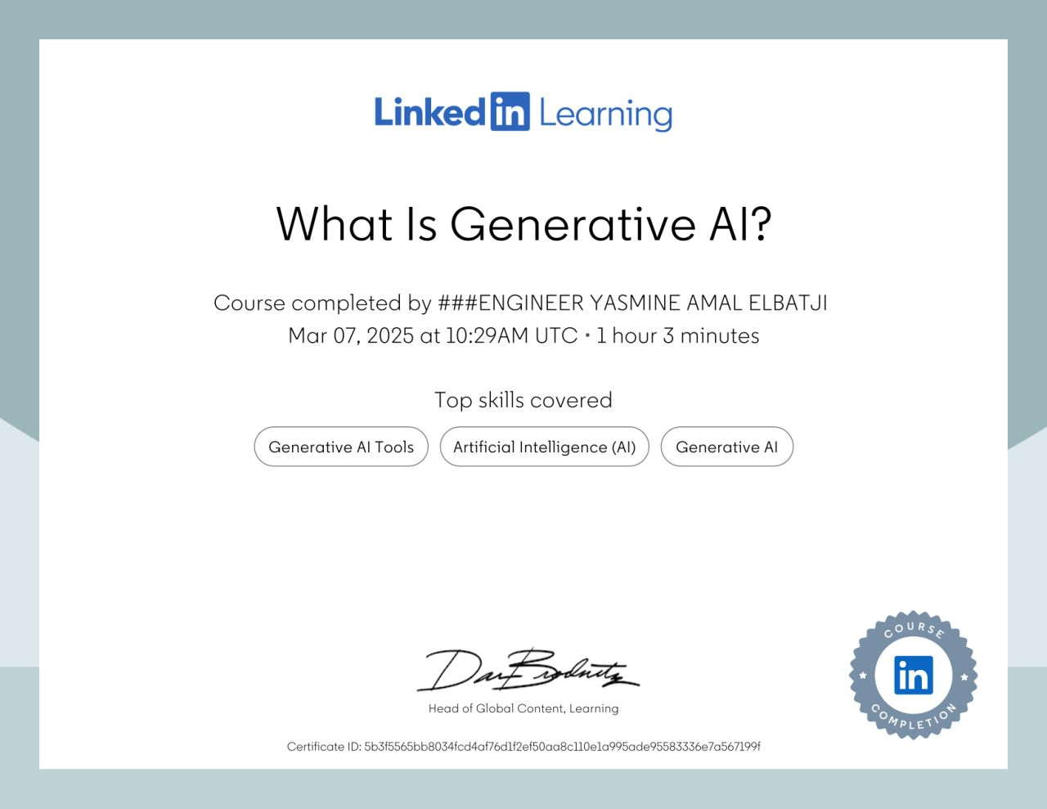

Slide 49
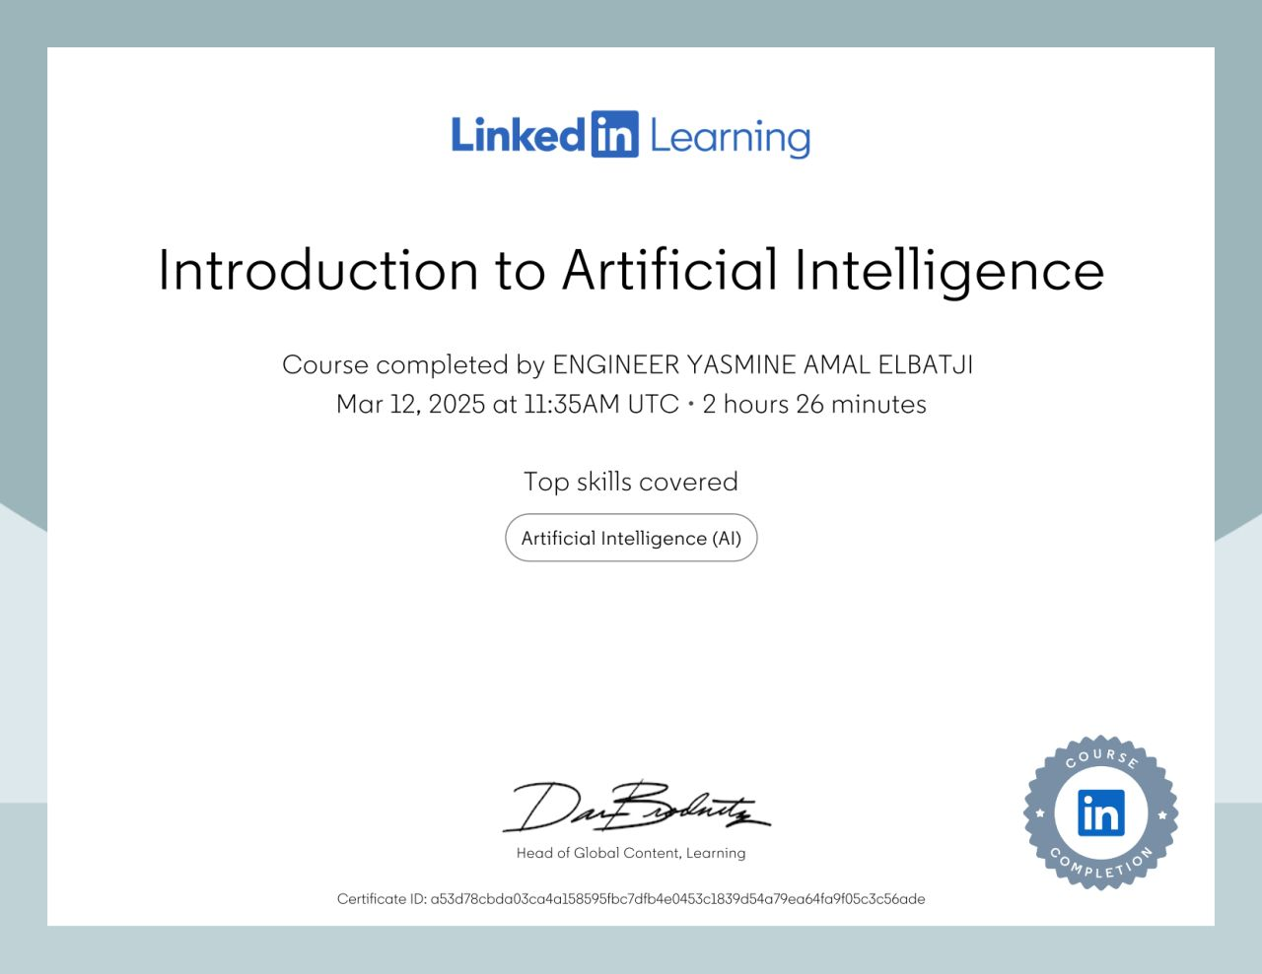

Slide 50
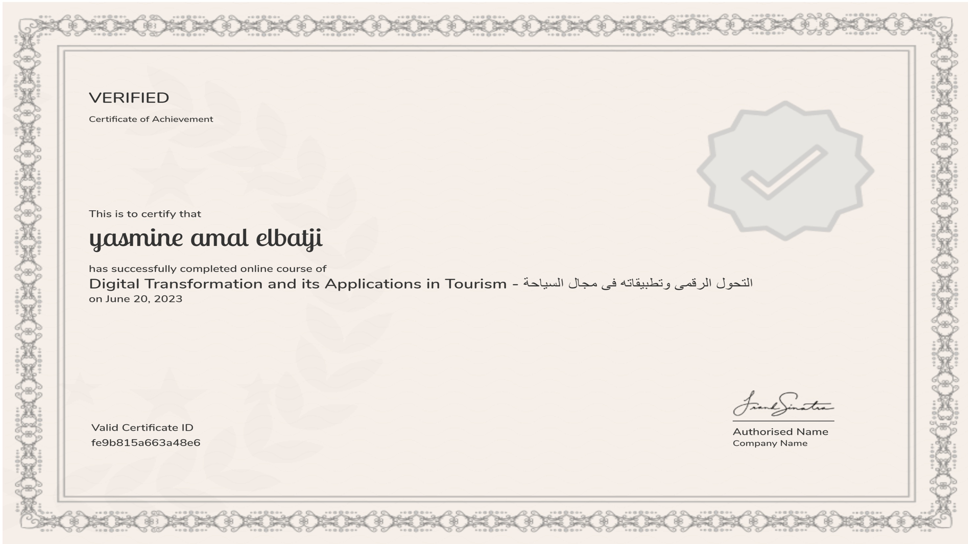

Slide 51
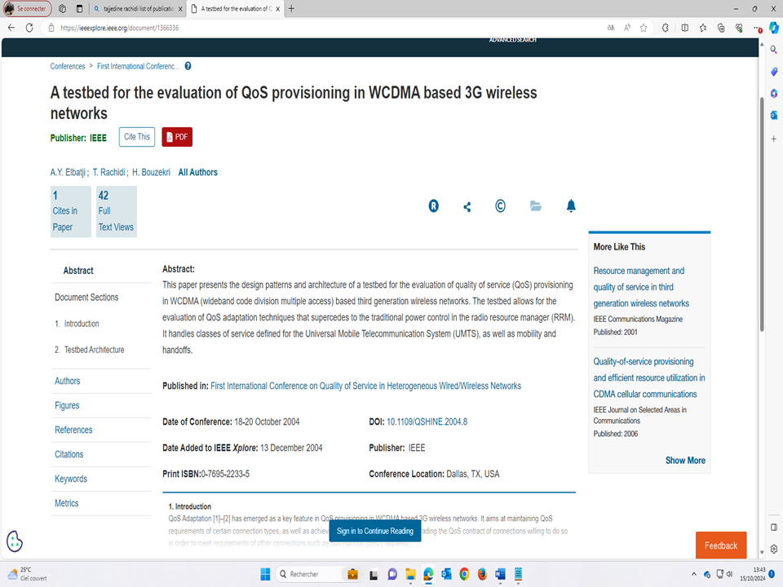

Slide 52
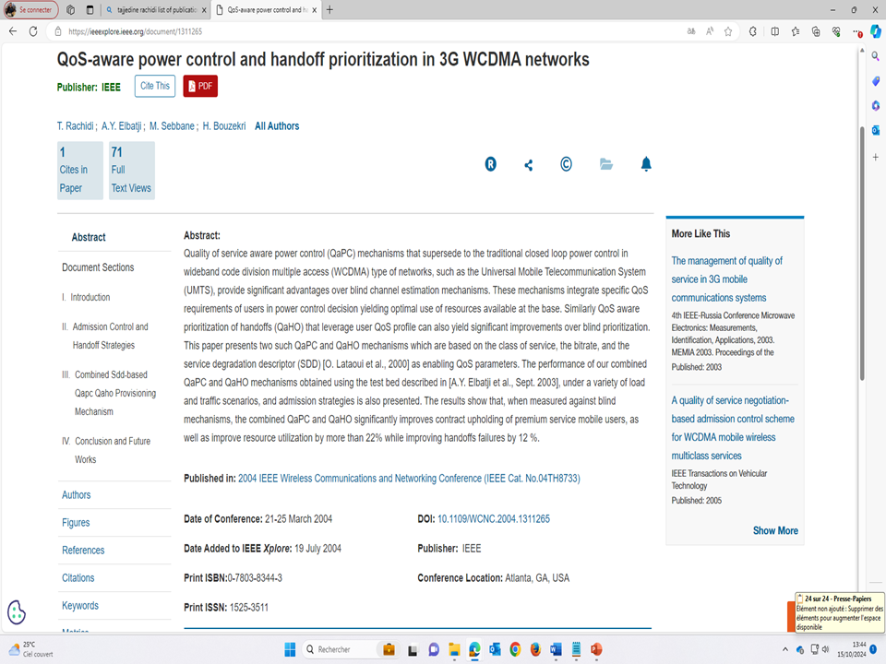

Slide 53
4 SCIENTIFIC PUBLICATIONS
T. Rachidi, A. Y. El Batji, M. Sebbane, and H. Bouzekri, (2005), "An Integrated System for QoS Provisioning in 3G WCDMA Cellular Networks", in Proc. of MWCN05, Marrakech in Morocco September 19-21
T. Rachidi, A. Y. El Batji, M. Sebbane, and H. Bouzekri, (2004), "QoS-aware Power Control and Handoff prioritization in 3G WCDMA Networks", Journal Marocain D'Automatique D'Informatique et de Traitement du Signal, pp99-112
"QoS-aware Power Control and Handoff prioritization in 3G WCDMA Networks", T. Rachidi, A. Y. El Batji, M. Sebbane, and H. Bouzekri, (2004), Proceedings of IEEE Wireless Communications and Networking Conference, WCNC04, March 21-25, Atlanta in America. (Ref 0-7803-8344-3/04(C) 2004 IEEE)
"A Testbed for the Evaluation of QoS Provisioning in WCDMA based 3G Wireless Networks", A. Y. El Batji, T. Rachidi, and H. Bouzekri (2003), Proceedings of the International Conference on Communication Systems and Networks, IASTED, CSN, September 8-10, Benelmadena in Spain, pp.31-36 (Ref 393-065).

Slide 54
In my master thesis, I designed and implemented a Testbed that is WCDMA-Compliant for the evaluation of quality-of-service adaptation in 3G networks. QoS adaptation aimed to maintain QoS requirements of active connections and handoffs to remove congestion.
The thesis employed different algorithms for congestion handling, and I represented my Al Akhawayn University in different international conferences of excellence in Spain (IASTED 2004), in the United States of America (WCNC 2004) and in England (INC 2004).
I am interested in Multi-Criteria Decision Making for Sustainable Development.
Through my future research, I will aim to design and implement models of sustainable development. I would like to present solutions that address climate change and help take sustainability decisions.
Additionally, I would like to collaborate with policymakers, urban planners, and communities for practical applications.

